Slide 1
CS6050/7050 : Computational Geometry
Haitao Wang
Assistant Professor
Department of Computer Science
Utah State University
haitao.wang@usu.edu

Slide 2
Computational geometry
Designing computer algorithms to solve geometric problems
A major area in computer science

Slide 3
Some examples
Finding the closest pair of points

Slide 4
Some examples (cont.)
Finding the farthest pair of points

Slide 5
Some examples (cont.)
Given n points in the plane, find the smallest circle containing all points

Slide 6
Some examples (cont.)
Determine whether there are two line segments intersecting each other
Computing all intersections

Slide 7
Voronoi diagrams (nearest neighbor searching)

Slide 8

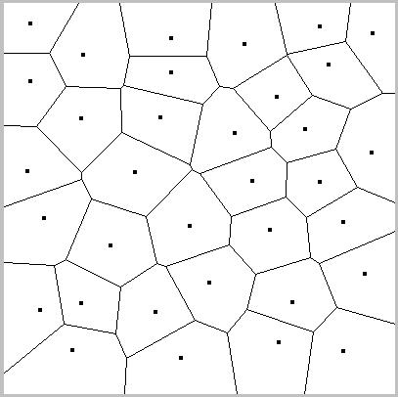
Voronoi diagrams (cont.)

Slide 9
Voronoi diagrams (cont.)
point locations

Slide 10
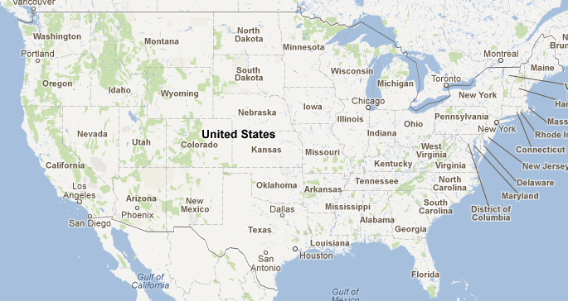
Point locations

Slide 11

The visibility polygon

Slide 12

Motivations: Guarding an art gallery
Question: Is there any point in the art gallery that cannot be
observed by the security guards?
The famous art gallery problem is to ask the minimum number of guards for
observing the whole gallery. Answer: n/3

Slide 13

Motivations: Guarding an art gallery
cone visibility

Slide 14
The visibility polygon (the point case)

Slide 15

The visibility polygon (the segment case)
the weak visibility polygon

Slide 16
The visibility polygon (the island case)
light

Slide 17
The visibility polygon in a polygonal domain
The point case

Slide 18
The visibility polygon in a polygonal domain (cont.)
The line segment case

Slide 19
The visibility polygon in a polygonal domain (cont.)
The island case
light

Slide 20
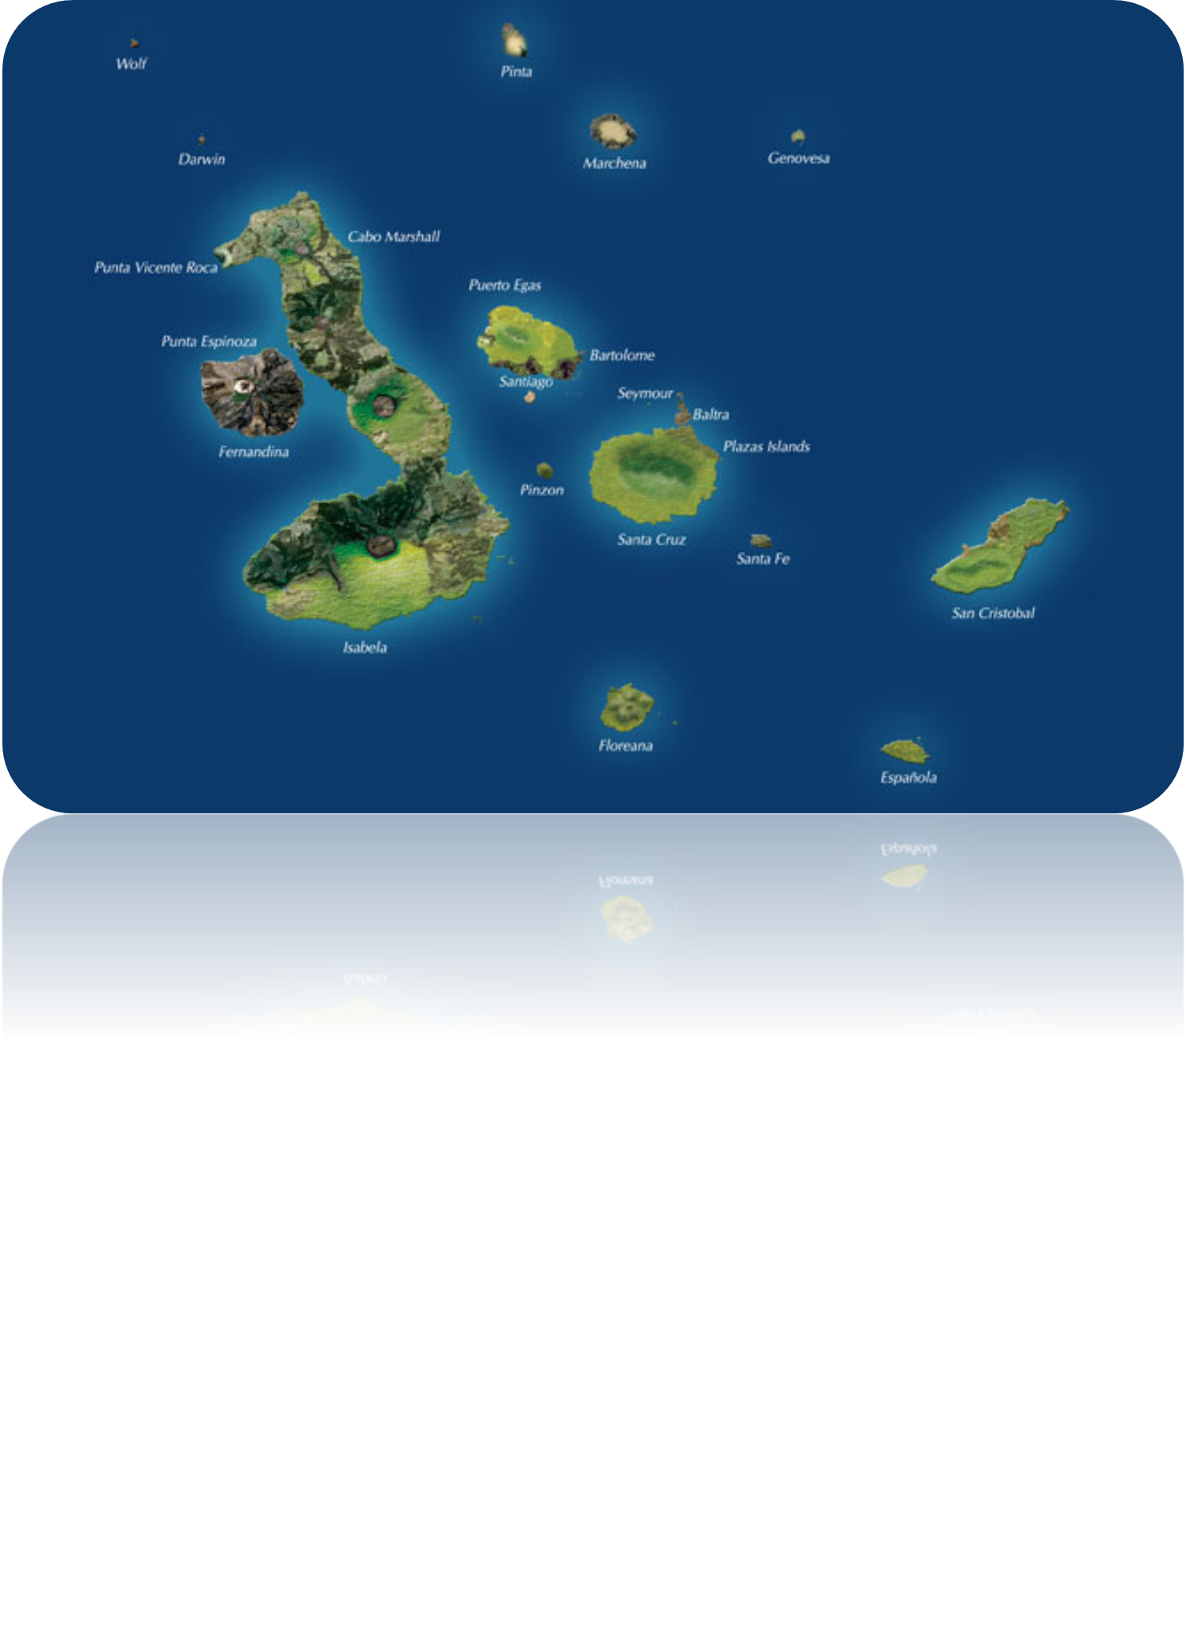
Shortest paths
a boat
destination

Slide 21
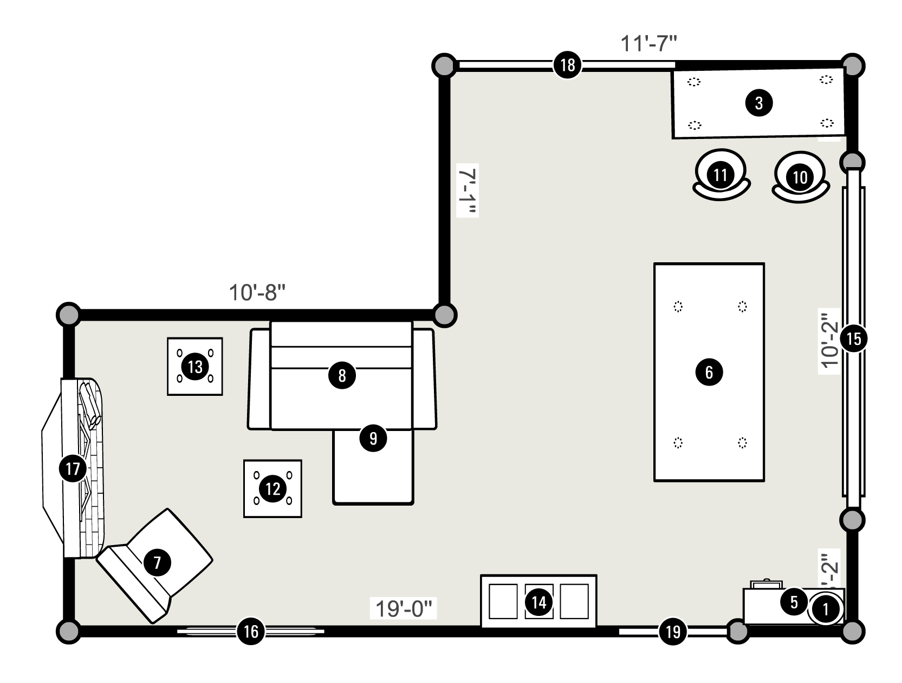
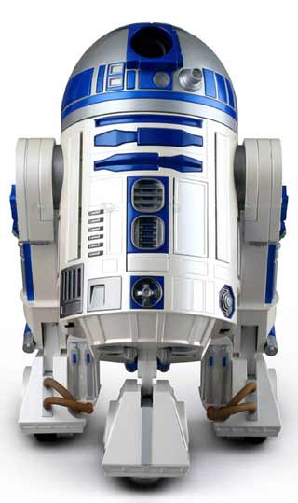
R2-D2

Slide 22
Shortest paths among obstacles
Obstacles are modeled as polygons
s: the source point
t: the destination point
n: total number of vertices of all obstacles
t
free space
s
obstacle

Slide 23
Two standard approaches
The visibility graph
The continuous Dijkstra

Slide 24
The visibility graph approach
Compute the visibility graph
Run Dijkstra’s algorithm on the graph
O(nlogn + K) time
K is the size of the graph
Ghosh and Mount, 87’
K=O(n²)
t
s
obstacle

Slide 25
The continuous Dijkstra approach
O(n log n) time
Hershberger and Suri, 99’
s
t

Slide 26
COURSE OVERVIEW

Slide 27
Topics (subject to change)
Convex hulls
Line segment intersections
Points triangulation
The closest pair problem
Linear programming
  Finding the lowest point in the common intersection of half-planes
The smallest enclosing circle

Slide 28
Topics (subject to change)
Orthogonal range searching
  Kd-trees
  ranges trees
Geometric data structures
  Interval trees
  Priority search trees
  Segment trees

Slide 29
Review on data structures and algorithms
Algorithm analysis
  big-O notation
Algorithm design techniques
  divide-and-conquer
    solving recurrences
  prune-and-search
  dynamic programming
  graph algorithms

Slide 30
Review on data structures and algorithms
Data structures
  Heap (binary heap)
    operations: extract-min, insertion, update-key
    O(log n) time for each operation
    O(n) time for building a heap
  Binary search tree (BST)
    operations: search, insertion, deletion
    balanced binary search tree
      AVL-tree, red-black tree
      O(log n) time for each operation
    O(n log n) time for building a balanced BST
    augumenting binary search trees
      associate extra information with the nodes

